Slide 1
PROJECT MANAGEMENT IN THE WAKE OF ESG
EKUA APPIAH-MENKA
JULY 2024

Slide 2
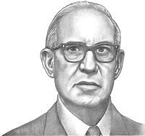
“Doing the right thing is more important than doing things right!!”
– Peter F. Drucker

Slide 3
CONTENT
1
2
3
OVERVIEW OF ESG
BENEFITS OF ESG IN PROJECT MANAGEMENT
ROLE OF PROJECT LEADERS

Slide 4
HISTORY OF ESG
Social Responsible Investing (SRI) emerged as a way for investors to align their portfolios.
1970s
1980s
Movement against companies doing business in South Africa during Apartheid gained momentum and overtime companies were compelled to do CSR in the communities they operate
The chemical industry introduced the first formal EHS management approach as a reaction to couple of catastrophic accidents (Seveso & Bhopal)
1985
1990s
ISO 14001 for Environmental Management and IFC established EHS guidelines.
ESG was first coined by UN Global Compact
2004

Slide 5
What is ESG?
E
environmental
A set of standards/criteria that a socially conscious investor and other stakeholders use to measure an organisation’s behaviour to determine the potential investment and/ or usage of the services.
S
ESG investment Considerations
social
What are the environmental considerations?
What is the social impact?
How are we reporting ?
G
governance

Slide 6
Environmental Social Governance
Social
Examine how an organisation
manages relationships with
employees, suppliers, customers, communities etc.
Goals: Ensuring healthy lives and promoting wellbeing for all at all ages, ensuring inclusive and equitable quality education and promoting lifelong learning opportunities for all.
Environmental
Governance
Criteria considers how a company safeguards the environment, this includes corporate policies that address climate change, waste management, water conservation.
Focuses on a company’s leadership,
executive pay, compliance, policies and procedures, internal controls and shareholder rights
Goals: Combatting climate change, ensuring access to affordable, reliable, sustainable, and modern energy for all.
Goals: managing risks and opportunities related to environmental, social, and governance criteria.

Slide 7
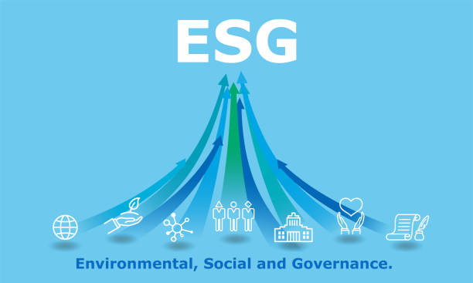
Why is ESG gaining momentum?
True business value is increasingly measured by assessing the impact of projects on customers, employees, shareholder, communities and the environment.
People want to work with and buy from organizations that are socially and environmentally responsible.
Investors prefer to put money in companies and project that meet the ESG criteria.
Organizations have started to realize the impact of their activities on the climate conditions (burning of fossil fuel, cutting down trees, etc.)
Fines, reputational damage and closure of companies that cause adverse impact in their environment and society (e.g. Shinefeel -Asutsuare plastic factory).

Slide 8
1. Risk Management Early Engagement helps to identify and address ESG risks. Steps required for risk-based approach are as follows; - Identification of material risks Systematically assess the environmental, social and governance factors that are most relevant to your industry and operations. - Proactive Mitigation Implement recommended mitigations to prevent occurrence of identified risks. e.g. Investment in renewable energy to reduce carbon footprints. Establishment of proper governance system to reduce legal and regulatory risks. - Enhance resilience in a VUCA world Adapt easily to changing market conditions Regulatory shifts Societal expectations
BENEFITS of ESG in Project Management
ESG considerations influence decision-making processes, stakeholder interactions and outcomes of projects. It also enhances reputation and increases competitiveness.
Key benefits of ESG include; risk management, stakeholder satisfaction, competitor advantage improved access to capital and potential for carbon accounting & trading.

Slide 9
2. Stakeholder Satisfaction and Competitive Advantage
BENEFITS of ESG in Project Management
Customers and stakeholders have become more conscious of ESG.
Proactive posture builds trust and goodwill leading to;
Employee retention
Community support
Customer loyalty
Customers are becoming more decerning
Sustainability is gradually becoming a key selling point that differentiates businesses.

Slide 10
3. Financial Rewards
Increase Capital
Improved access to funding
Companies that demonstrate a proactive approach to managing ESG risks are more likely to attract capital and maintain investor confidence
Lower capital costs
Carbon accounting & trading
Calculation of GHG emissions.
Implementation of initiatives and tracking of effectiveness
Improves ESG ratings(e.g. One Airport square)
Carbon offsets can be sold to organisations that are large emitters of GHG. (forestry commission)

Slide 11
Role of Project Leaders in Driving ESG
Understand the processes/ clarity on operations.
Project prioritization - most impactful to the organization.
Create awareness and empower team members.
Clearly define ESG goals – ensure the project has ESG objectives(e.g. waste management, community well-being, ethical reporting).
Develop KPIs. Spell out success matrix.
Identify and engage key stakeholders (internal & external) - continuously engage stakeholders to ensure alignment.
Categorize the impact of the project - long term, short term, temporary.
Innovation – solve future problems today

Slide 12
Challenges/ Impediments
Resistance to change
Cost concerns
Limited expertise
Final Thoughts
Admittedly the dynamics may vary slightly in Ghana but in a few years addressing ESG factors will no longer be choice but a necessity for long-term success.
Let’s embrace and incorporate ESG as part of our projects and business strategy as the long-term benefit on the bottom line and our future far outweighs the initial cost.

Slide 13
“Managers do things right; leaders do the right things!” – Warren Bennis

Slide 14
Thank you
Ekua Appiah-menka
Manager, research & strategy
Bulk energy storage & transportation ltd
ekua.appiah-menka@bost.gov.gh
0503781388

